Slide 1

6. Relational Databases (1)
www.pdbmbook.com

Slide 2
Introduction
Relational Model
Normalization
Mapping a conceptual ER model to a relational model
Mapping a conceptual EER model to a relational model

Slide 3
Relational Model
Basic Concepts
Formal Definitions
Types of Keys
Relational Constraints
Example Relational Model

Slide 4
Basic Concepts
Relational model was first formalized by Edgar F. Codd in 1970
Relational model is a formal data model with a sound mathematical foundation, based on set theory and first order predicate logic
No graphical representation
Commonly adopted to build both logical and internal data models
Microsoft SQL Server, IBM DB2 and Oracle

Slide 5
Basic Concepts
A database is represented as a collection of relations
A relation is defined as a set of tuples that each represent a similar real world entity
A tuple is an ordered list of attribute values that each describe an aspect of an entity

Slide 6
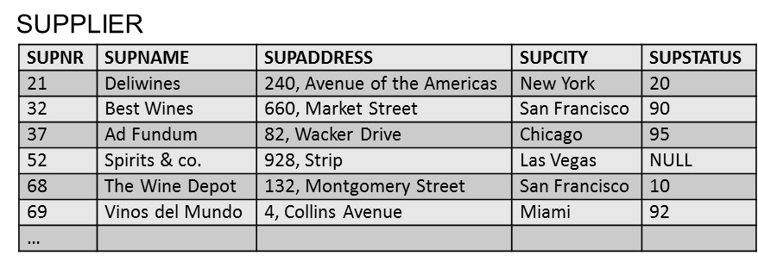
Basic Concepts

Slide 7
Basic Concepts
EER model | Relational Model
Entity type | Relation
Entity | Tuple
Attribute type | Column name
Attribute | Cell

Slide 8
Basic Concepts
Student (Studentnr, Name, HomePhone, Address)
Professor (SSN, Name, HomePhone, OfficePhone, E-mail)
Course (CourseNo, CourseName)

Slide 9
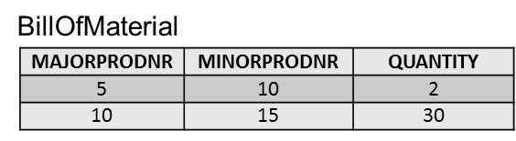
Formal Definitions
A domain specifies the range of admissible values for an attribute type
  Example: gender domain, time domain
Each attribute type is defined using a corresponding domain
A domain can be used multiple times in a relation

Slide 10
Formal Definitions
A relation R(A₁, A₂, A₃,… A_{n}) can now be formally defined as a set of m tuples r = {t₁, t₂, t₃,… t_{m}} whereby each tuple t is an ordered list of n values t = <v₁, v₂, v₃,… v_{n}> corresponding to a particular entity
  each value v_{i} is an element of the corresponding domain, dom(A_{i}), or is a special NULL value
  NULL value means that the value is missing, irrelevant or not applicable

Slide 11
Formal Definitions
Student(100, Michael Johnson, 123 456 789, 532 Seventh Avenue)
Professor(50, Bart Baesens, NULL, 876 543 210, Bart.Baesens@kuleuven.be)
Course(10, Principles of Database Management)

Slide 12
Formal Definitions
A relation essentially represents a set (no ordering + no duplicates!)
The domain constraint states that the value of each attribute type A must be an atomic and single value from the domain dom(A)
Example: COURSE(coursenr, coursename, study points)
(10, Principles of Database Management, 6)
(10, {Principles of Database Management, Database Modeling}, 6) ➔ WRONG!

Slide 13
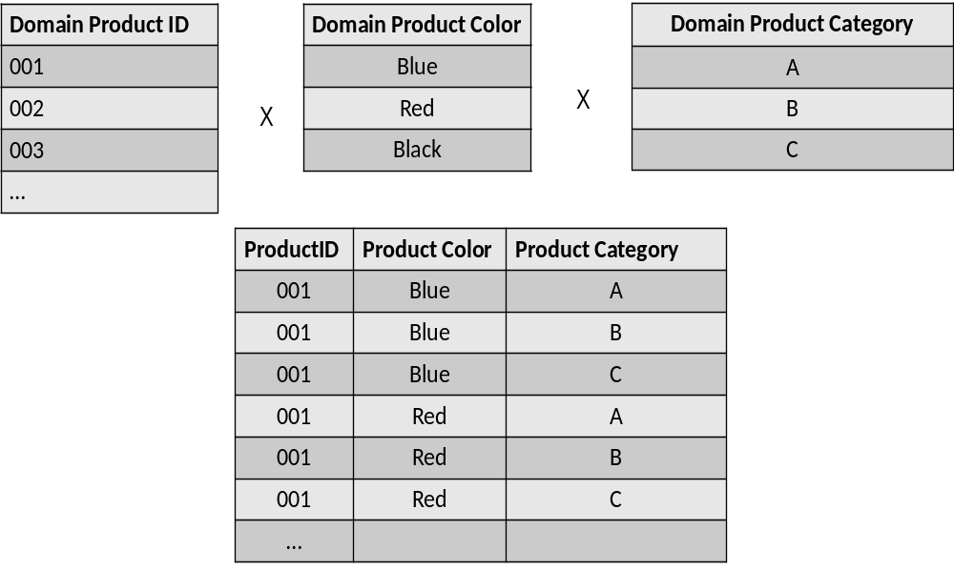
Formal Definitions
A relation R of degree n on the domains dom(A₁), dom(A₂), dom(A₃), … , dom(A_{n}) can also be alternatively defined as a subset of the Cartesian product of the domains that define each of the attribute types

Slide 14
Types of Keys
Superkeys and Keys
Candidate Keys, Primary Keys, Alternative Keys
Foreign Keys

Slide 15
Superkeys and Keys
A superkey is defined as a subset of attribute types of a relation R with the property that no two tuples in any relation state should have the same combination of values for these attribute types
A superkey specifies a uniqueness constraint
A superkey can have redundant attribute types
Example: (Studentnr, Name, HomePhone)

Slide 16
Superkeys and Keys
A key K of a relation scheme R is a superkey of R with the additional property that removing any attribute type from K leaves a set of attribute types that is no superkey of R
A key does not have any redundant attribute types (minimal superkey)
Example: Studentnr
The key constraint states that every relation must have at least 1 key that allows to uniquely identify its tuples

Slide 17
Candidate Keys, Primary Keys and Alternative Keys
A relation may have more than one key (candidate keys)
  PRODUCT: product number and product name
Primary key is used to identify tuples in the relation, to establish connections to other relations and for storage purposes
  Entity integrity constraint: attribute types that make up the primary key should always satisfy a NOT NULL constraint
Other candidate keys are then referred to as alternative keys

Slide 18
Foreign Keys
A set of attribute types FK in a relation R₁ is a foreign key of R₁ if two conditions are satisfied (referential integrity constraint)
  the attribute types in FK have the same domains as the primary key attribute types PK of a relation R₂
  a value FK in a tuple t₁ of the current state r₁ either occurs as a value of PK for some tuple t₂ in the current state r₂ or is NULL

Slide 19
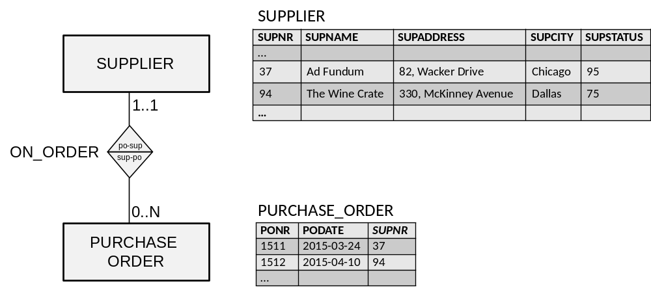
Foreign Keys

Slide 20
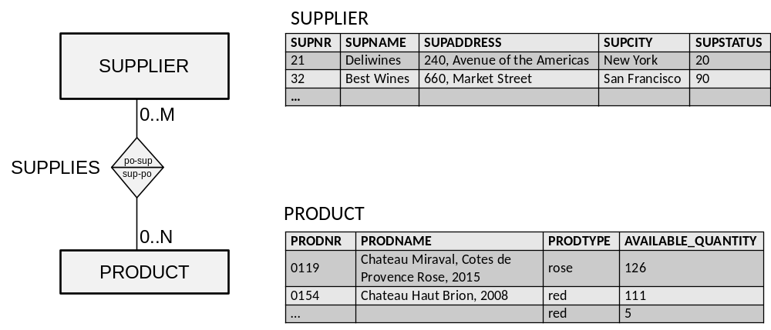
Foreign Keys

Slide 21
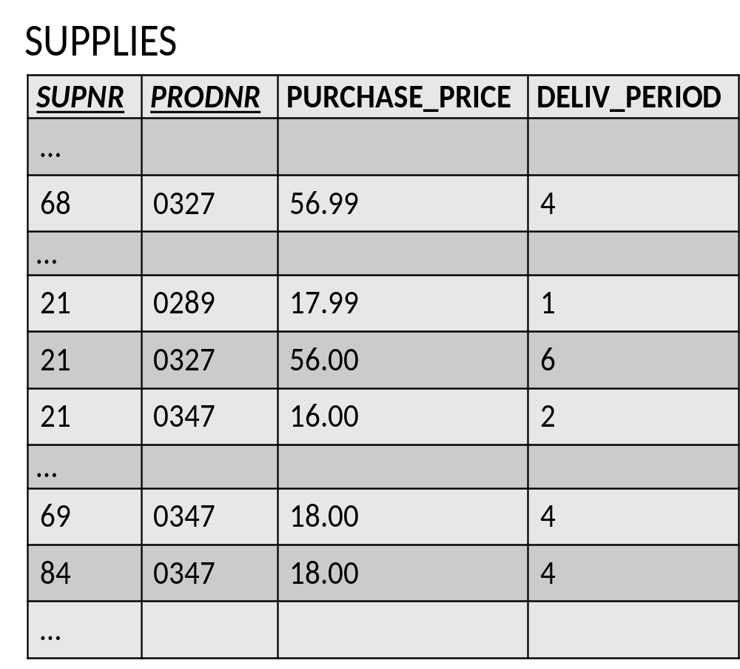
Foreign Keys

Slide 22
Relational Constraints
Domain constraint | The value of each attribute type A must be an atomic and single value from the domain dom(A).
Key constraint | Every relation has a key that allows to uniquely identify its tuples.
Entity integrity constraint | The attribute types that make up the primary key should always satisfy a NOT NULL constraint.
Referential integrity constraint | A foreign key FK has the same domain as the primary key PK attribute type(s) it refers to and either occurs as a value of PK or NULL.

Slide 23
Example Relational Data Model
SUPPLIER(SUPNR, SUPNAME, SUPADDRESS, SUPCITY, SUPSTATUS)
PRODUCT(PRODNR, PRODNAME, PRODTYPE, AVAILABLE QUANTITY)
SUPPLIES(SUPNR, PRODNR, PURCHASE_PRICE, DELIV_PERIOD)
PURCHASE_ORDER(PONR, PODATE, SUPNR)
PO_LINE(PONR, PRODNR, QUANTITY)

Slide 24
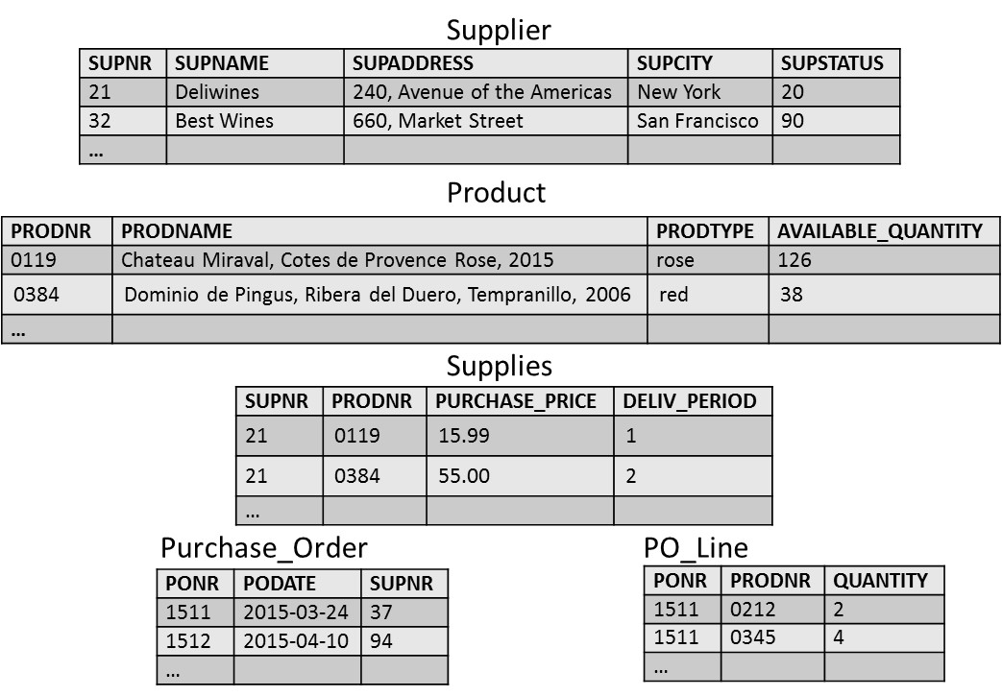
Example Relational Data Model

Slide 25
Normalization
Insertion, Deletion and Update Anomalies
Informal Normalization guidelines
Functional Dependencies and Prime Attribute Type
Normalization forms

Slide 26
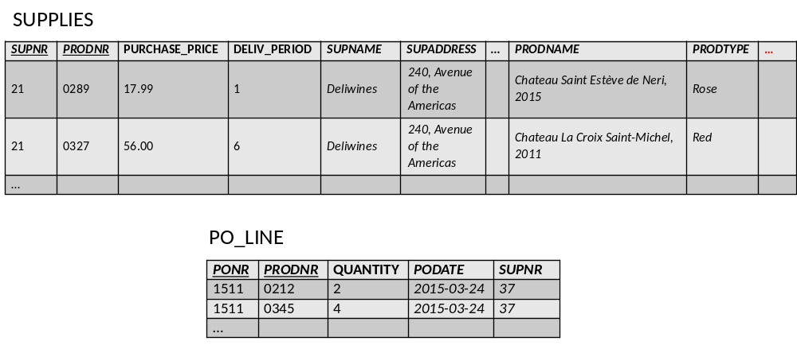
Insertion, Deletion and Update Anomalies

Slide 27
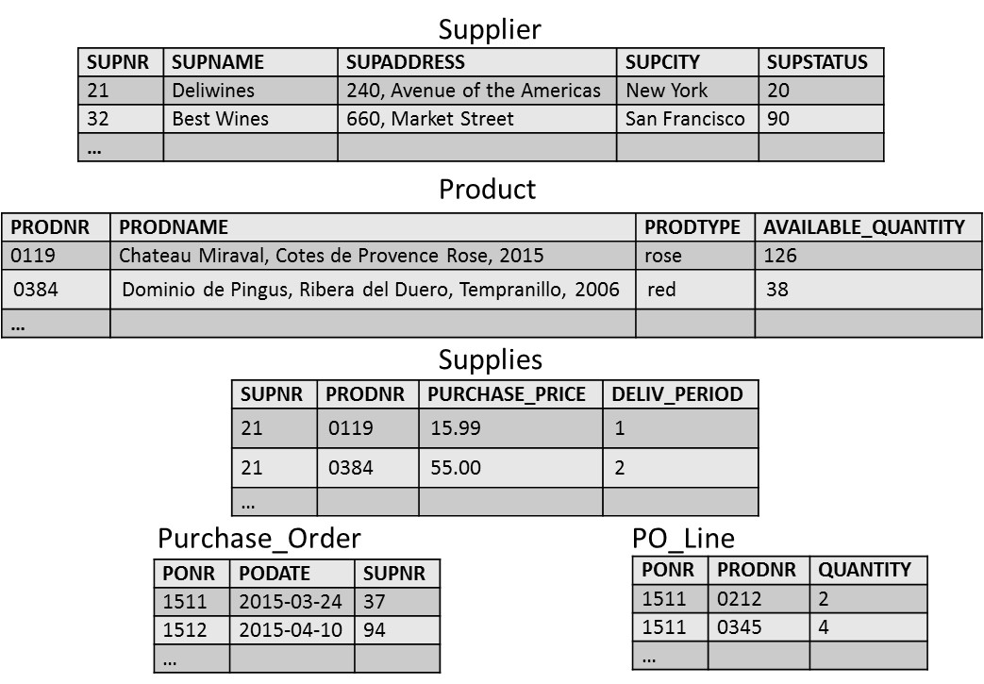
Insertion, Deletion and Update Anomalies

Slide 28
Insertion, Deletion and Update Anomalies
To have a good relational data model, all relations in the model should be normalized
A formal normalization procedure can be applied to transform an unnormalized relational model into a normalized form.
The advantages are twofold:
  At the logical level, the users can easily understand the meaning of the data and formulate correct queries
  At the implementation level, the storage space is used efficiently and the risk of inconsistent updates is reduced

Slide 29
Informal Normalization Guidelines
Design a relational model in such a way that it is easy to explain its meaning
  MYRELATION123(SUPNR, SUPNAME, SUPTWITTER, PRODNR, PRODNAME, …) versus SUPPLIER(SUPNR, SUPNAME, SUPTWITTER, PRODNR, PRODNAME, ……)
Attribute types from multiple entity types should not be combined in a single relation
Avoid excessive amount of NULL values in a relation
  SUPPLIER(SUPNR, SUPNAME, …)
  SUPPLIER-TWITTER(SUPNR, SUPTWITTER)

Slide 30
Functional Dependencies and Prime Attribute Type
A functional dependency X → Y, between two sets of attribute types X and Y implies that a value of X uniquely determines a value of Y
  there is a functional dependency from X to Y or Y is functionally dependent on X
Examples:
  SSN → ENAME
  PNUMBER → {PNAME, PLOCATION}
  {SSN, PNUMBER} → HOURS

Slide 31
Functional Dependencies and Prime Attribute Type
A prime attribute type is an attribute type that is part of a candidate key
Example: R1(SSN, PNUMBER, PNAME, HOURS)
  Prime attribute types: SSN and PNUMBER
  Non-prime attribute types: PNAME and HOURS

Slide 32
Normalization Forms
First Normal Form (1 NF)
Second Normal Form (2 NF)
Third Normal Form (3 NF)
Boyce-Codd Normal Form (BCNF)
Fourth Normal Form (4 NF)

Slide 33
First Normal Form (1 NF)
The first normal form (1 NF) states that every attribute type of a relation must be atomic and single valued
  no composite or multivalued attribute types (domain constraint!)
SUPPLIER(SUPNR, NAME(FIRST NAME, LAST NAME), SUPSTATUS)
SUPPLIER(SUPNR, FIRST NAME, LAST NAME, SUPSTATUS)

Slide 34
First Normal Form (1 NF)
DEPARTMENT(DNUMBER, DLOCATION, DMGRSSN)
  Assumption: a department can have multiple locations and multiple departments are possible at a given location
DEPARTMENT(DNUMBER, DMGRSSN)
DEP-LOCATION(DNUMBER, DLOCATION)

Slide 35
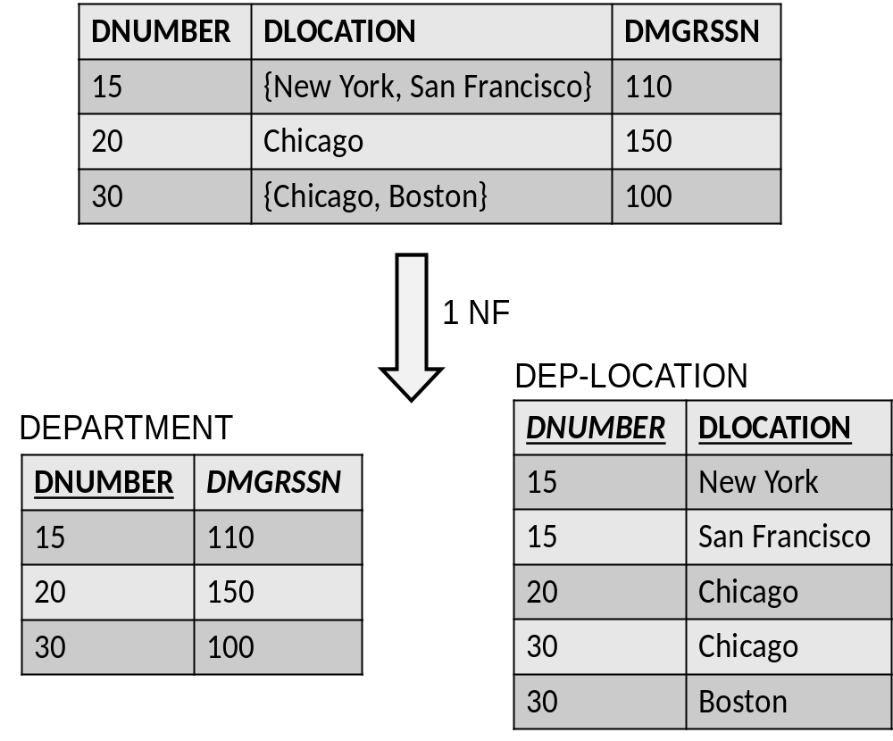
First Normal Form (1 NF)

Slide 36
First Normal Form (1 NF)
R1(SSN, ENAME, DNUMBER, DNAME, PROJECT(PNUMBER, PNAME, HOURS))
  assume an employee can work on multiple projects and multiple employees can work on the same project
R11(SSN, ENAME, DNUMBER, DNAME)
R12(SSN, PNUMBER, PNAME, HOURS)

Slide 37
Second Normal Form (2 NF)
A functional dependency X → Y is a full functional dependency if removal of any attribute type A from X means that the dependency does not hold anymore
  Examples: SSN, PNUMBER → HOURS; PNUMBER → PNAME
A functional dependency X → Y is a partial dependency if an attribute type A from X can be removed from X and the dependency still holds
  Example: SSN, PNUMBER → PNAME

Slide 38
Second Normal Form (2 NF)
A relation R is in the second normal form (2 NF) if it satisfies 1 NF and every non-prime attribute type A in R is fully functional dependent on any key of R
If the relation is not in second normal form, we must:
  decompose it and set up a new relation for each partial key together with its dependent attribute types
  keep a relation with the original primary key and any attribute types that are fully functional dependent on it

Slide 39
Second Normal Form (2 NF)
R1(SSN, PNUMBER, PNAME, HOURS)
  assume an employee can work on multiple projects; multiple employees can work on the same project and a project has a unique name
R11(SSN, PNUMBER, HOURS)
R12(PNUMBER, PNAME)

Slide 40
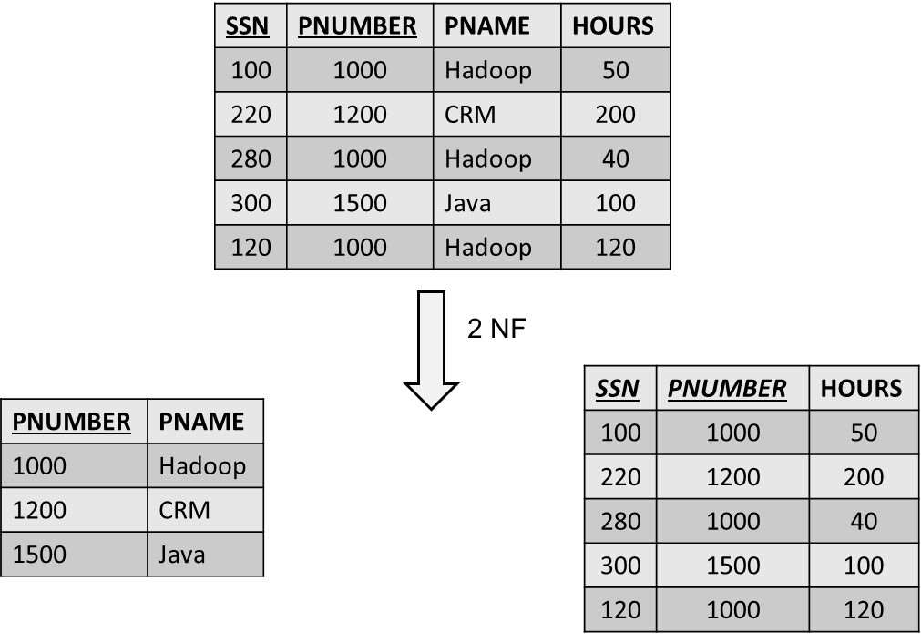
Second Normal Form (2 NF)

Slide 41
Third Normal Form (3 NF)
A functional dependency X → Y in a relation R is a transitive dependency if there is a set of attribute types Z that is neither a candidate key nor a subset of any key of R, and both X → Z and Z → Y hold
A relation is in the third normal form (3 NF) if it satisfies 2 NF and no non-prime attribute type of R is transitively dependent on the primary key
If the relation is not in third normal form, we need to decompose the relation R and set up a relation that includes the non-key attribute types that functionally determine the other non-key attribute types

Slide 42
Third Normal Form (3 NF)
R1(SSN, ENAME, DNUMBER, DNAME, DMGRSSN)
  Assume an employee works in one department, a department can have multiple employees and a department has one manager
R11(SSN, ENAME, DNUMBER)
R12(DNUMBER, DNAME, DMGRSSN)

Slide 43
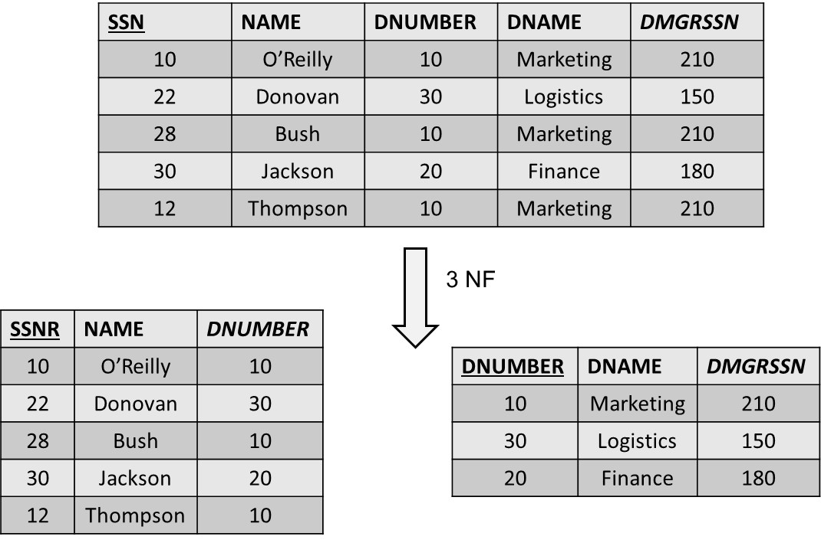
Third Normal Form (3 NF)

Slide 44
Boyce-Codd Normal Form (BCNF)
A functional dependency X → Y is called a trivial functional dependency if Y is a subset of X
  Example: SSN, NAME → SSN
A relation R is in the Boyce-Codd normal form (BCNF) provided each of its non-trivial functional dependencies X → Y, X is a superkey—that is, X is either a candidate key or a superset thereof
BCNF normal form is stricter than the third normal form
  Every relation in BCNF is also in 3 NF (not vice versa)

Slide 45
Boyce-Codd Normal Form (BCNF)
R1(SUPNR, SUPNAME, PRODNR, QUANTITY)
  Assume a supplier can supply multiple products; a product can be supplied by multiple suppliers and a supplier has a unique name
R11(SUPNR, PRODNR, QUANTITY)
R12(SUPNR, SUPNAME)

Slide 46
Fourth Normal Form (4 NF)
There is a multivalued dependency from X to Y, X →→ Y, if and only if each X value exactly determines a set of Y values, independently of the other attribute types
A relation is in the fourth normal form (4 NF) if it is in Boyce-Codd normal form and for every one of its non-trivial multivalued dependencies X →→ Y, X is a superkey—that is, X is either a candidate key or a superset thereof

Slide 47
Fourth Normal Form (4 NF)
R1(course, instructor, textbook)
  Assume a course can be taught by different instructors, and a course uses the same set of textbooks for each instructor
R11(course, textbook)
R12(course, instructor)

Slide 48
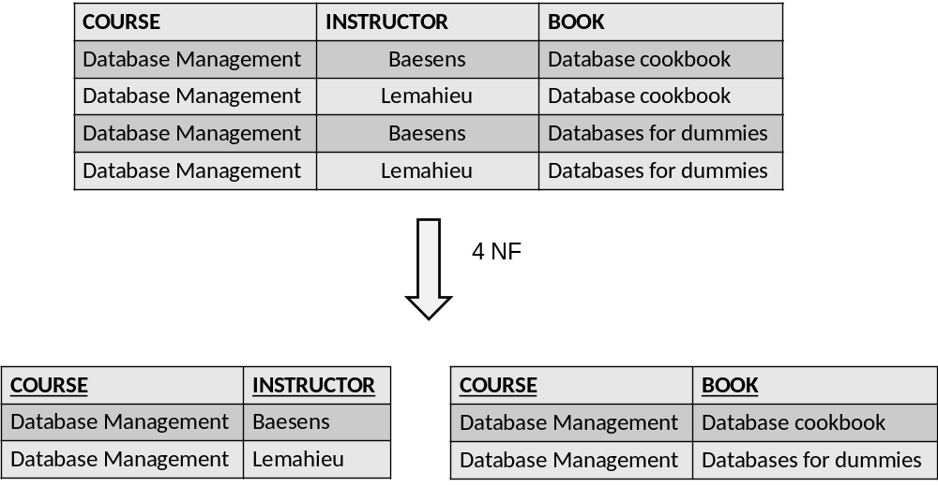
Fourth Normal Form (4 NF)

Slide 49
More information?
www.pdbmbook.com

